Slide 1
Spatial Filtering
A spatial filter consists of (a) a neighborhood, and (b) a predefined operation
Linear (filter that implements a linear operation) spatial filtering of an image of size MxN with a filter of size mxn is given by the expression

Slide 2
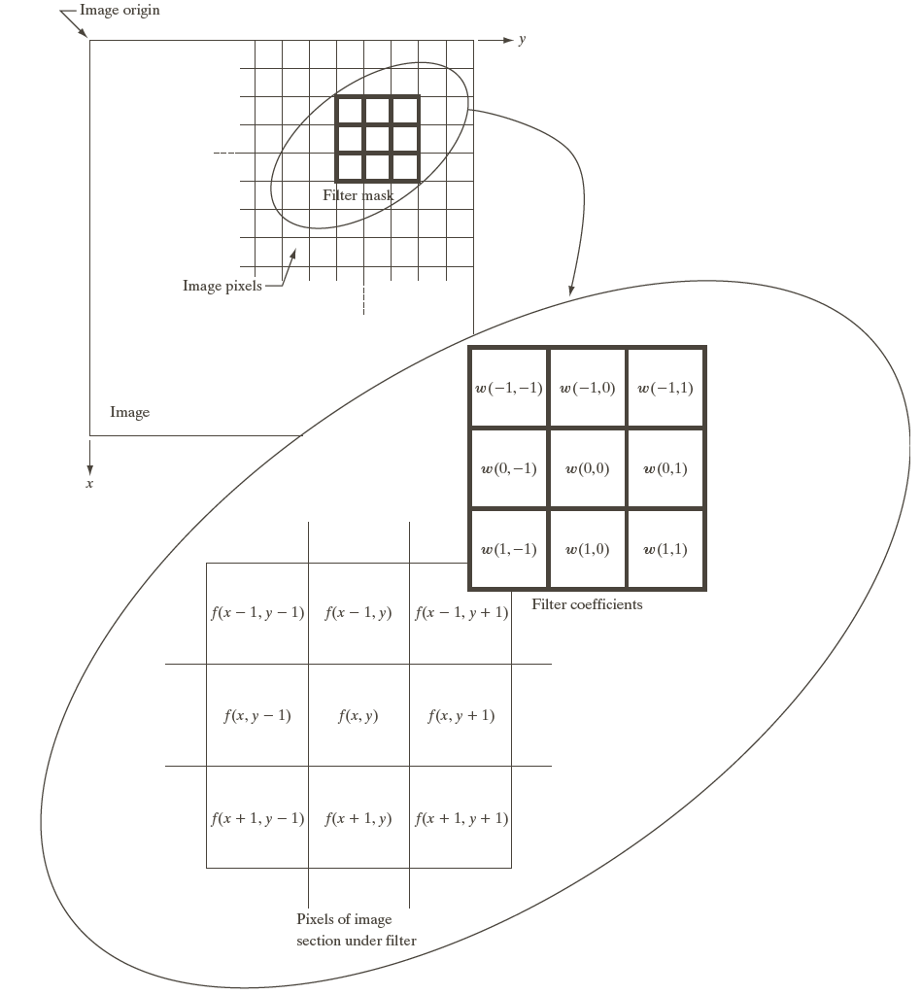

Spatial Filtering

Slide 3
Spatial Correlation
Sum of the product

Slide 4
Spatial Convolution
Same thing but convolution is associative !!

Slide 5
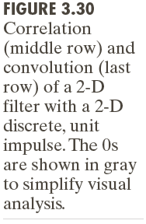
Notes:
Padding minimum by m-1 rows and n-1 cols top bottom right left

Slide 6
Smoothing Spatial Filters
Smoothing filters are used for blurring and for noise reduction
Blurring is used in removal of small details and bridging of small gaps in lines or curves
Smoothing spatial filters include linear filters and nonlinear filters.

Slide 7
Spatial Smoothing Linear Filters

Slide 8
Two Smoothing Averaging Filter Masks

Slide 10
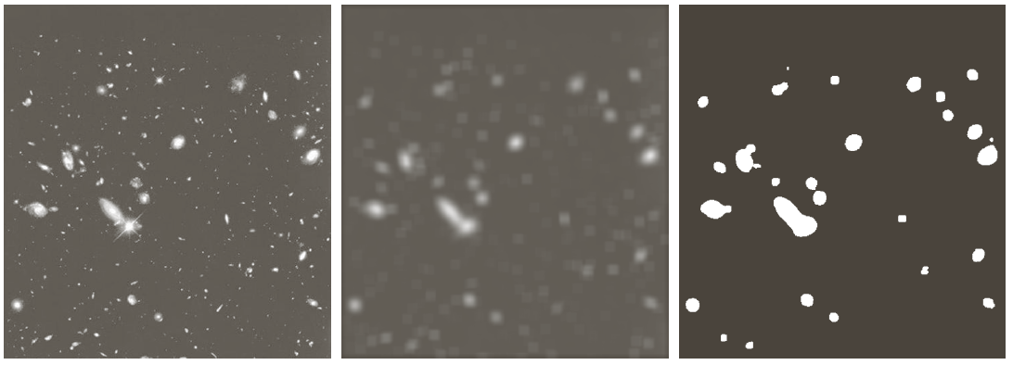
Example: Gross Representation of Objects

Slide 11
Order-statistic (Nonlinear) Filters
— Nonlinear
— Based on ordering (ranking) the pixels contained in the filter mask
— Replacing the value of the center pixel with the value determined by the ranking result
E.g., median filter, max filter, min filter

Slide 12
Example: Use of Median Filtering for Noise Reduction

Slide 13
Sharpening Spatial Filters
Foundation
Laplacian Operator
Unsharp Masking and Highboost Filtering
Using First-Order Derivatives for Nonlinear Image Sharpening — The Gradient

Slide 14
Sharpening Spatial Filters: Foundation
The first-order derivative of a one-dimensional function f(x) is the difference
The second-order derivative of f(x) as the difference

Slide 15
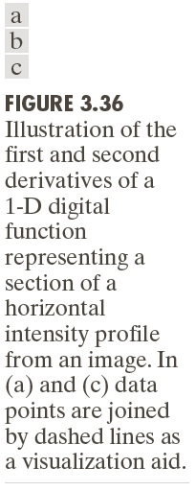

Slide 16
Sharpening Spatial Filters: Laplace Operator
The second-order isotropic derivative operator is the Laplacian for a function (image) f(x,y)

Slide 17
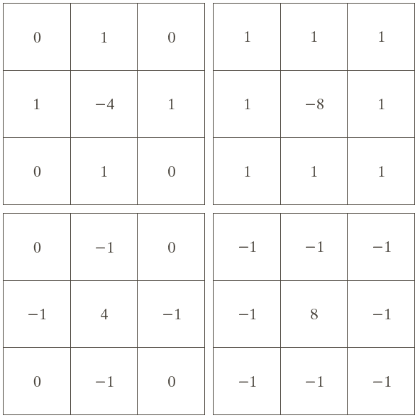
Sharpening Spatial Filters: Laplace Operator

Slide 18
Sharpening Spatial Filters: Laplace Operator
Image sharpening in the way of using the Laplacian:

Slide 19
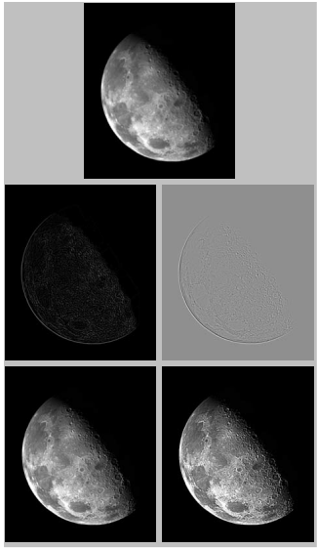
Notes:
A typical way to scale a Laplacian image is to add to it its minimum value to
bring the new minimum to zero and then scale the result to the full
intensity range, as explained in Eqs. (2.6-10) and (2.6-11).
y= ((x-min)/(max-min))*255

Slide 20
Image scaling (Ch2)
(OR) y= ((x-min)/(max-min))*255

Slide 21
Unsharp Masking and Highboost Filtering
Unsharp masking
Sharpen images consists of subtracting an unsharp (smoothed) version of an image from the original image
e.g., printing and publishing industry
Steps
1. Blur the original image
2. Subtract the blurred image from the original (creates a mask)
3. Add the mask to the original

Slide 22
Unsharp Masking: Demo

Slide 23
Unsharp Masking and Highboost Filtering

Slide 24
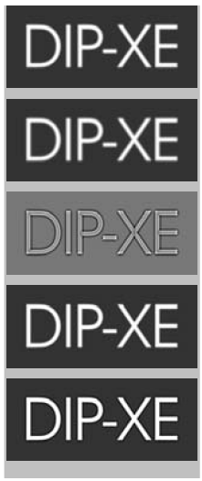
Unsharp Masking and Highboost Filtering: Example

Slide 25
Image Sharpening based on First-Order Derivatives
Gradient Image

Slide 26
Image Sharpening based on First-Order Derivatives
z₁ | z₂ | z₃
z₄ | z₅ | z₆
z₇ | z₈ | z₉

Slide 27
Image Sharpening based on First-Order Derivatives
z₁ | z₂ | z₃
z₄ | z₅ | z₆
z₇ | z₈ | z₉
Notes:
The idea behind using a weight value of 2 in the center coefficient is to achieve some
smoothing by giving more importance to the center point (we discuss this in
more detail in Chapter 10).

Slide 28
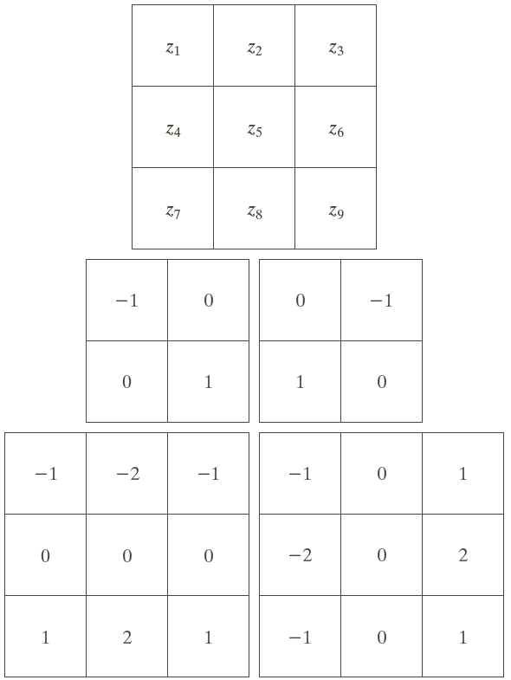
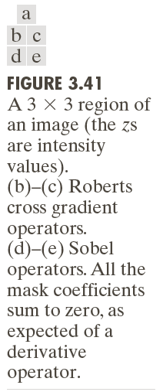
Image Sharpening based on First-Order Derivatives
Notes:
Note that the coefficients in all the masks shown in
Fig. 3.41 sum to 0, indicating that they would give a response of 0 in an area of
constant intensity, as is expected of a derivative operator.

Slide 29
Example
Notes:
The edge defects also are quite visible in this image, but with the
added advantage that constant or slowly varying shades of gray have been
eliminated, thus simplifying considerably the computational task required for
automated inspection.

Slide 30
Example: Combining Spatial Enhancement Methods Goal: Enhance the image by sharpening it and by bringing out more of the skeletal detail

Slide 31
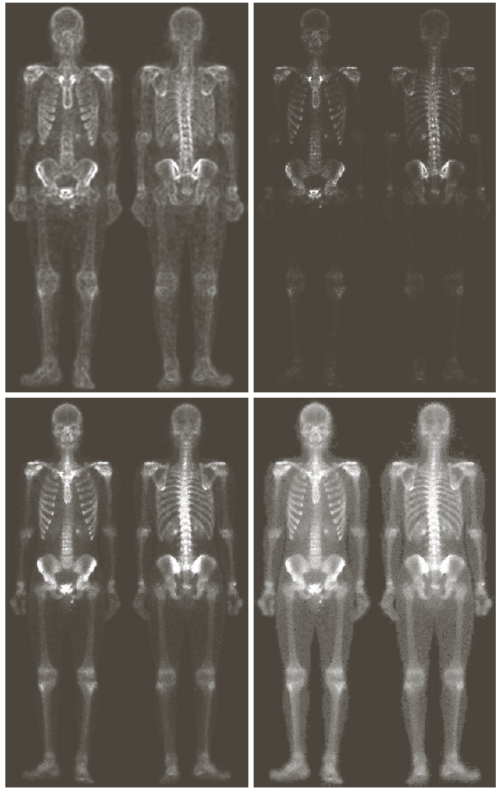
Example: Combining Spatial Enhancement Methods Goal: Enhance the image by sharpening it and by bringing out more of the skeletal detail

